Slide 1
Economic Forecasting
Carl Fletcher
For this project I would like to create a data pipeline that can help prepare data for economic forecasting.
This pipeline should check it’s data before it is ingested for use.

Slide 2
Who will get value from this?
1
Work in risk management
2
Work in economic research and forecasting
3
Work in investing and asset management
4
Work in consumer spending
5
Like to trade on the side
6
Want to plan for the future

Slide 3

Data Inputs/Sources
Government Spending
The government gives a lot of information through agencies. They are a huge spender and supporter for the economy.
Stock Data
Commodity
Data
Geopolitical Data
Consumer Behavior
This can be pulled through API’s and is useful for gauging expectations in the economy
This can come from API’s websites and other tools. This can help see if there is a market shock and can help with understanding expectations.
This can be received from government and private entities. This would be a hard data point to use since it is so complex, But it helps understand structural risk,
This helps fill the gap the other tools may have. This can be pulled from private institutions,

Slide 4
Three Phases for the Project
1
2
3
Data Ingestion
Data Validation
Data Serving
This will be the part of the tool that will gather the data from various source.s.
Each team member can focus on a type of data.
Data test will be created to confirm that this data is correct and is properly flowing through the pipeline.
The data will need to be available for usage in the correct format.
Note: If we want we can break the project up into these three parts and have one person over each part.
Notes:
Phase 1 — Data Ingestion
The first phase focuses on sourcing and pulling together all relevant data. Each team member will take ownership of one data category, building the pipelines necessary to reliably extract data from their assigned sources. The deliverable for this phase is a centralized raw data repository that consolidates all inputs in one place, with no transformation applied yet — just reliable extraction and storage. Data orchestration tooling will be introduced here to schedule and automate the ingestion process so that the pipeline runs consistently without manual intervention.
Phase 2 — Data Validation and Transformation
The second phase is the core focus of this project. Once the data has been ingested, it must be rigorously validated and transformed before it can be trusted or used. This includes checking for missing values, inconsistencies, and outliers within individual sources, as well as ensuring that data from different sources aligns correctly when combined — accounting for differences in format, granularity, timing, and units of measurement. The goal is to produce a clean, standardized, and well-documented dataset where every input has been verified, reconciled, and appropriately structured. No data moves forward to Phase 3 without passing these quality checks.
Phase 3 — Data Serving
With a validated and well-structured dataset in hand, the third phase focuses on making the data accessible and usable. The deliverable here is not a prediction or a machine learning model — it is a clean, well-organized output that an analyst, data scientist, or downstream application can immediately consume. This could take the form of a structured database, a set of standardized flat files, or a basic dashboard visualizing key economic indicators. The emphasis is on accessibility, clarity, and readiness for use.

Slide 5
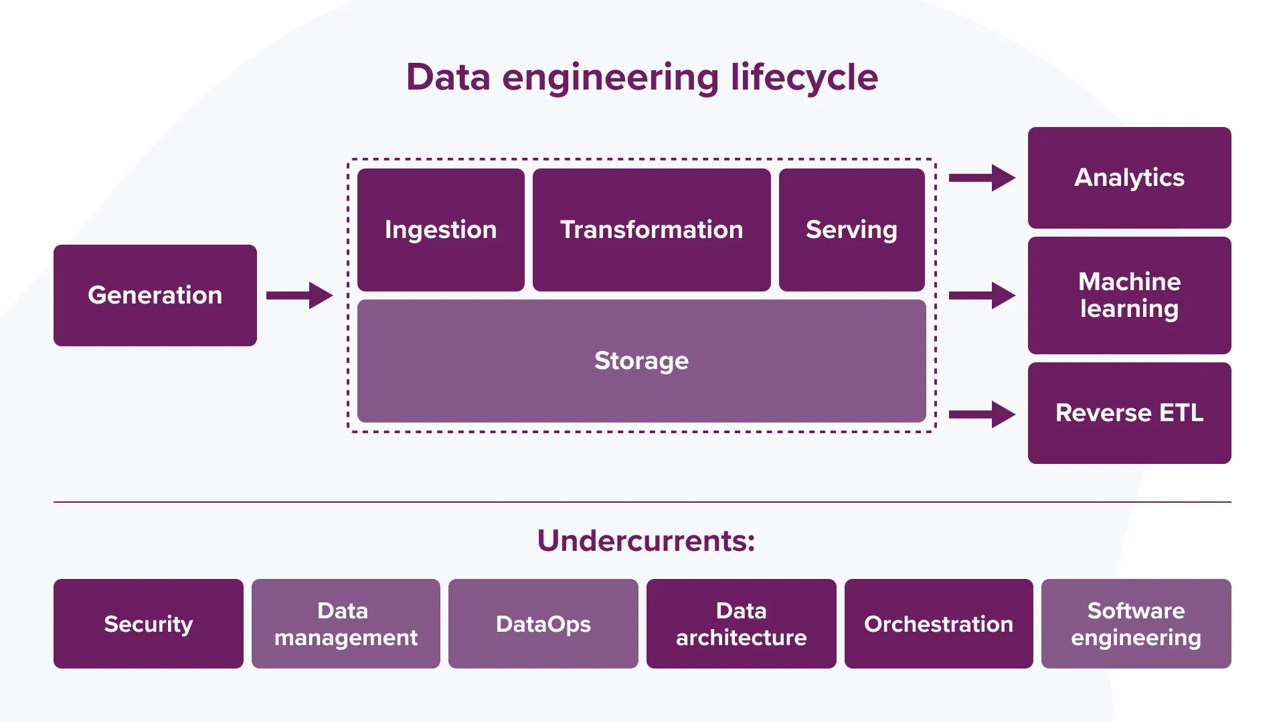
This project will focus on ingesting, transforming and serving data for usage.

Slide 6
Value of Data Engineering
High-quality data is essential for producing accurate estimations.
Flexibility is crucial, as economics is constantly evolving and changing.
Risk reduction is a highly technical field that prioritizes precision and accuracy.
Supports effective data organization and ensures information remains current and up to date
Notes:
Data ingestion: Sourcing and reliably pulling data from multiple disparate APIs and reports, some of which may be unstructured or inconsistently formatted
Cross-source integration: Reconciling data from sources with different formats, update cadences, and quality standards is one of the most technically demanding aspects of this project
Validation logic: Designing checks that can catch both obvious errors and subtle inconsistencies that could compromise the integrity of the final dataset
Orchestration: Ensuring that all pipeline stages are properly sequenced, automated, and monitored so the system runs reliably over time

Slide 7
Challenges and Risk
Data ingestion: Sourcing and reliably pulling data from multiple disparate APIs and reports, some of which may be unstructured or inconsistently formatted
Cross-source integration: Reconciling data from sources with different formats, update cadences, and quality standards is one of the most technically demanding aspects of this project
Validation logic: Designing checks that can catch both obvious errors and subtle inconsistencies that could compromise the integrity of the final dataset
Orchestration: Ensuring that all pipeline stages are properly sequenced, automated, and monitored so the system runs reliably over time
Notes:
Data ingestion: Sourcing and reliably pulling data from multiple disparate APIs and reports, some of which may be unstructured or inconsistently formatted
Cross-source integration: Reconciling data from sources with different formats, update cadences, and quality standards is one of the most technically demanding aspects of this project
Validation logic: Designing checks that can catch both obvious errors and subtle inconsistencies that could compromise the integrity of the final dataset
Orchestration: Ensuring that all pipeline stages are properly sequenced, automated, and monitored so the system runs reliably over time

Slide 8
Additional Thoughts
For this project I want the output to be a pipeline that can be ran that can give an output of values based off of economic inputs.
The outputs should be numbers of some sort: percentages, points, etc. Once these values are assigned an app should be able to pick this up and use it however it wants.
Note: I haven’t picked which file format I want to use.
Two approaches I have for this project:
Team members can focus on individual inputs and making them digestible
Or
Team members can focus on a part of the data process mentioned in slide 4

Slide 9
Appendix

Slide 10
Value Statement
Clear, clean, reliable economic data is critical for any teams and individuals that makes decisions based on market conditions. Rather than providing predictions directly, this pipeline should deliver the analysis-ready data those organizations need to power their own models, dashboards, and decision-making processes similar to what AI models now can already produce. The value here is in the quality and reliability of the data itself. Users will be able to plug the pipeline in directly into tools without having to worry about data integrity, we will have the pipeline do it for us.

Slide 11
Data Sources
Stock and crypto market APIs
FRED (Federal Reserve Economic Data)
Corporate earnings reports
Government spending bills and financial reports (e.g., the Monthly Treasury Statement)
Private Company Data
Balance Sheet Data (Walmart and Amazon)

